Slide 1
工 作 汇 报
郝前秀

Slide 2
科研：
ACM MM2021 Came ready，整理代码
KDD论文扩充期刊，增加理论分析
项目：
社会媒体知识图谱：
前端可视化数据统计
风险知识图谱：
调研路径推理方法

Slide 3
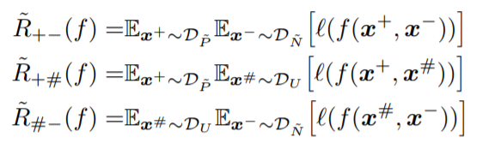





Semi-supervised AUC Optimization with Class-conditional Noises: Theory and Algorithms
定义AUC Risk：
其中
可推导出，当代理损失满足 时，下列成立：

Slide 4
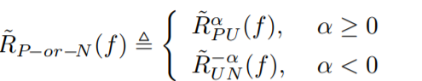
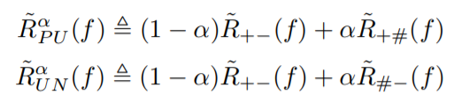
Semi-supervised AUC Optimization with Class-conditional Noises: Theory and Algorithms
The proposed combined risk:
where α ∈ [−1, 1] is a trade-off parameter

Slide 5
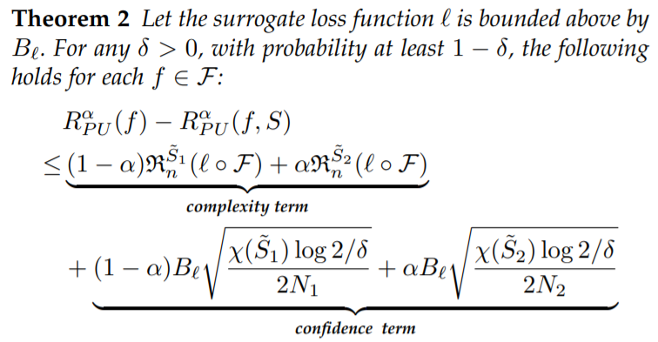

Semi-supervised AUC Optimization with Class-conditional Noises: Theory and Algorithms

Slide 6
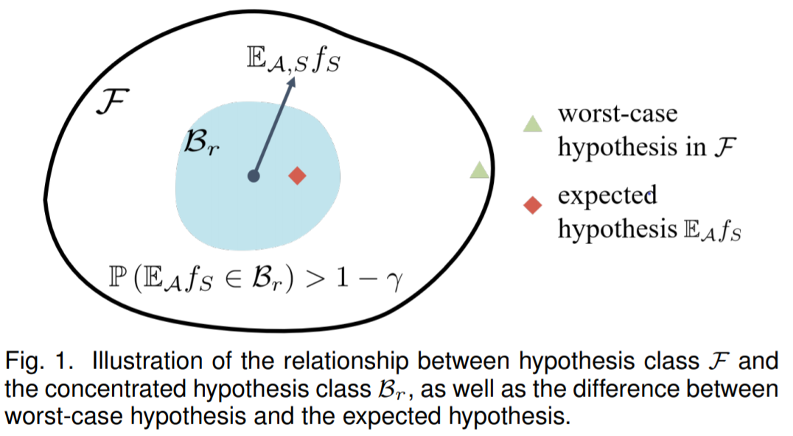
Semi-supervised AUC Optimization with Class-conditional Noises: Theory and Algorithms

Slide 7
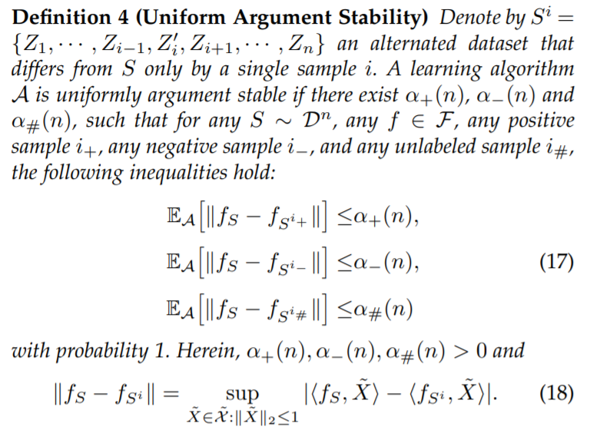
Semi-supervised AUC Optimization with Class-conditional Noises: Theory and Algorithms

Slide 8
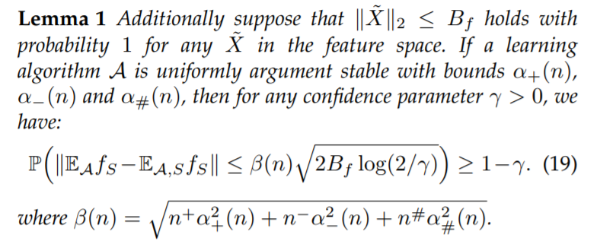
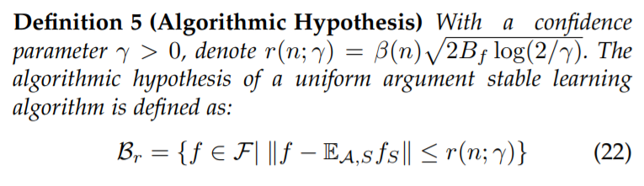
Semi-supervised AUC Optimization with Class-conditional Noises: Theory and Algorithms

Slide 9
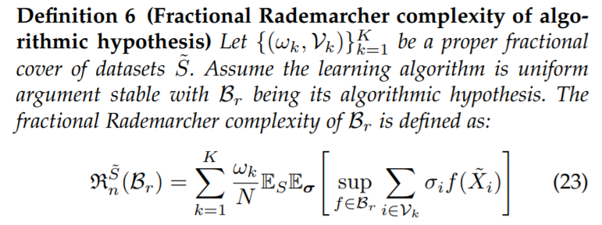

Semi-supervised AUC Optimization with Class-conditional Noises: Theory and Algorithms

Slide 10
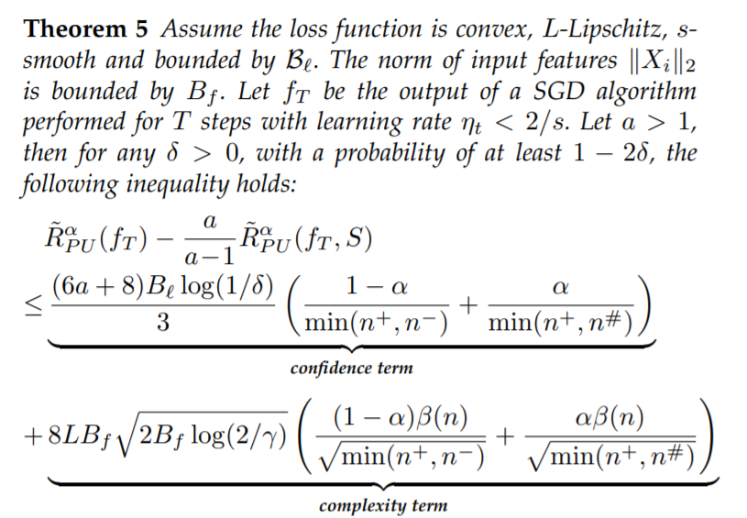
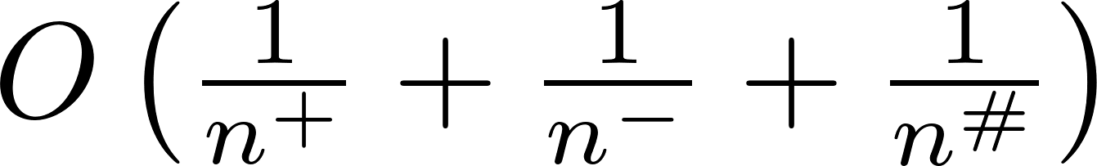
Semi-supervised AUC Optimization with Class-conditional Noises: Theory and Algorithms

Slide 11
谢 谢

